Slide 1
People Counter using Thermal Tripwire Sensor
Team 13: Janis Intoy and Emily Lam
April 19th, 2017

Slide 2
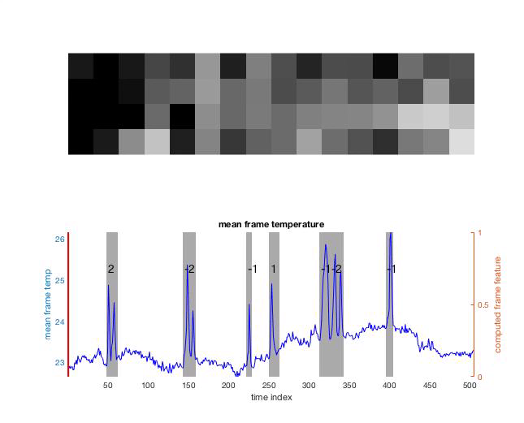
Problem Statement
The efficiency of HVAC (Heating Ventilation & Air Conditioning) systems can be improved by making them adaptive to the number of people in a room.
In order to estimate a room’s occupancy level, the Occusense Senior Design team has created a reliable, thermal sensor system to capture the motion of people through doorways.
We aim to develop a reliable, real- time algorithm to detect the direction of motion of people passing through in order to track the number of people in the room.

Slide 3
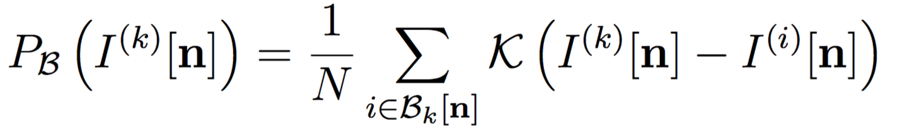
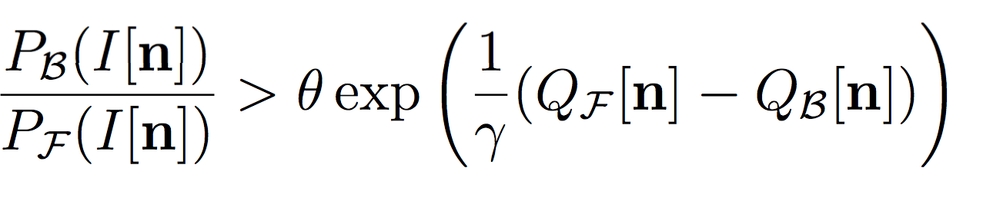
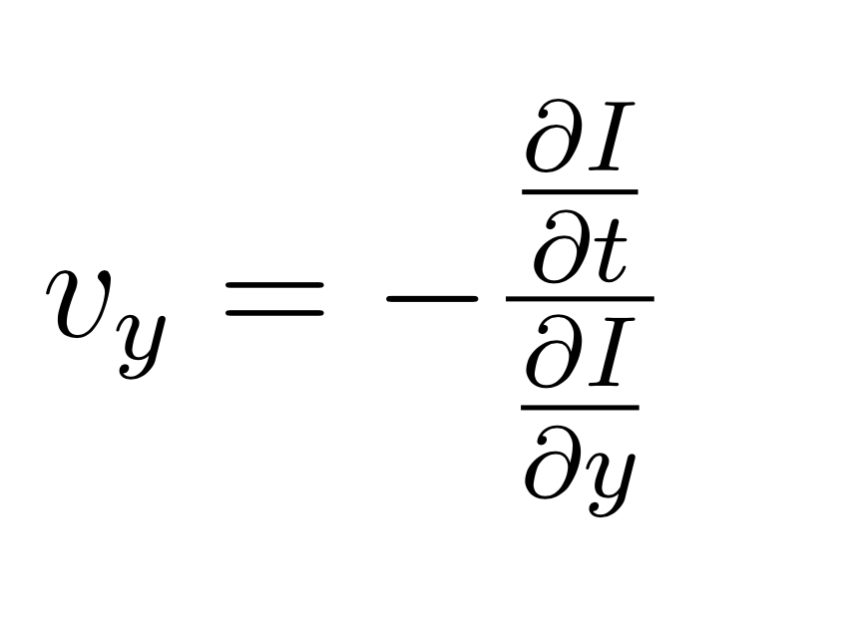
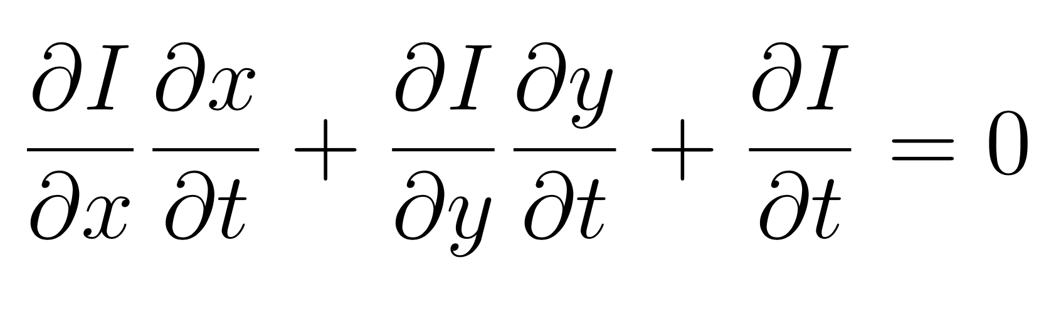
Proposed Solution
Our approach breaks the problem into two parts:
detect a person in the doorway
foreground-adaptive background subtraction
Assumptions:
background has slow temporal dynamics
data starts with some number of background-only frames
determine the direction of motion of the person
Gradient based optical flow algorithm
Assumptions:
only vertical velocity matters

Slide 4
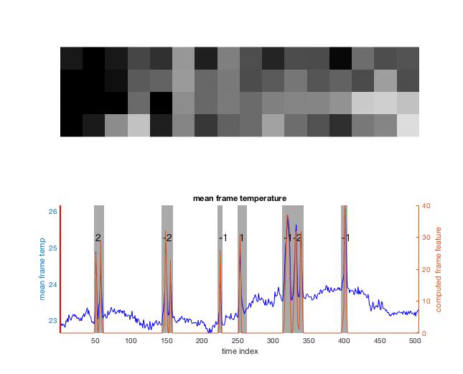
Background Subtraction

Slide 5
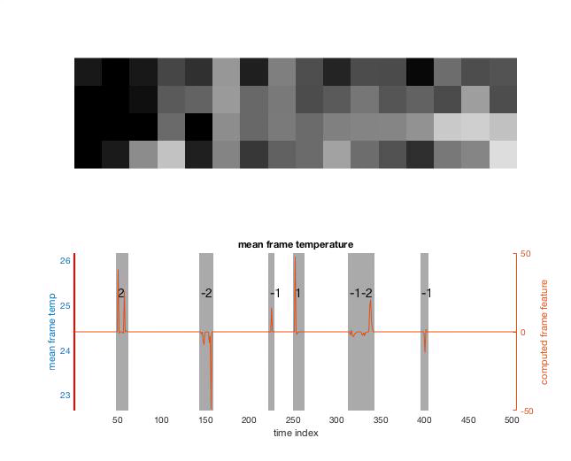
Optical Flow

Slide 6
Next Steps
Optimize optical flow and background subtraction algorithm
Try out different methods from the ones that we implemented
Currently, at 80% accuracy
Collect exotic data
People lingering by the door
Multiple people walking in and out in quick succession
People wearing jackets
Reach Goal: Integrate with senior design team for real-time implementation

